Slide 1

Transistors & Opamp
Jadhav V. N.
B.Tech, ME(Electronics)
Assistant Professor
Department of E&TC
Zeal COER, Pune - 41

Slide 2

BJT Introduction
The semiconductor devices cannot amplify a signal,
The next development in semiconductor device is a BJT (bipolar junction transistor).
Three terminal device – collector, emitter, and base. Base is a control terminal.
A signal of small amplitude applied to the base
is available in the “magnified” form at the
collector of the transistor.
Thus the large power signal is obtained from
a small power signal.

Slide 3
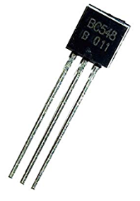
Why is it called transistor ?
The term transistor was derived from the words TRANSFER & RESISTOR.
Transfers input signal current from a low resistance path to a high resistance path.

Slide 4
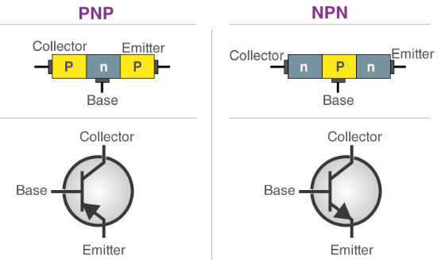
NPN PNP Transistor

Slide 5
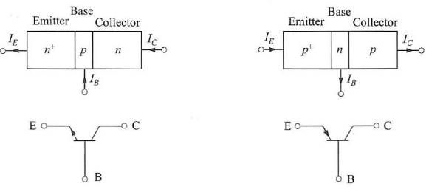
The BJT – Bipolar Junction Transistor

Slide 6
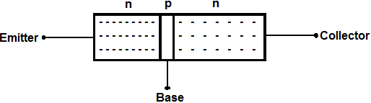
BJT Doping:
Emitter>Collector>Base

Slide 7
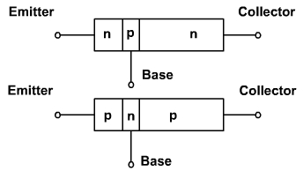
BJT Area:
Collector>Emitter>Base

Slide 8
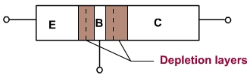
BJT Depletion Layer:
Depletion Layer: CB>EB

Slide 9
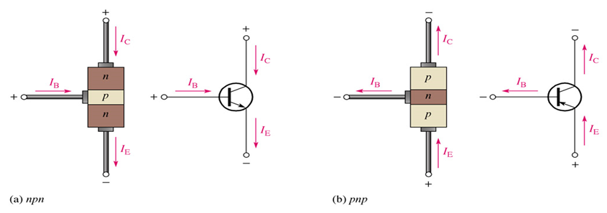
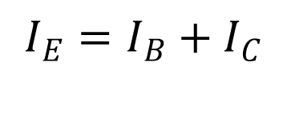
Transistor currents

